Slide 1
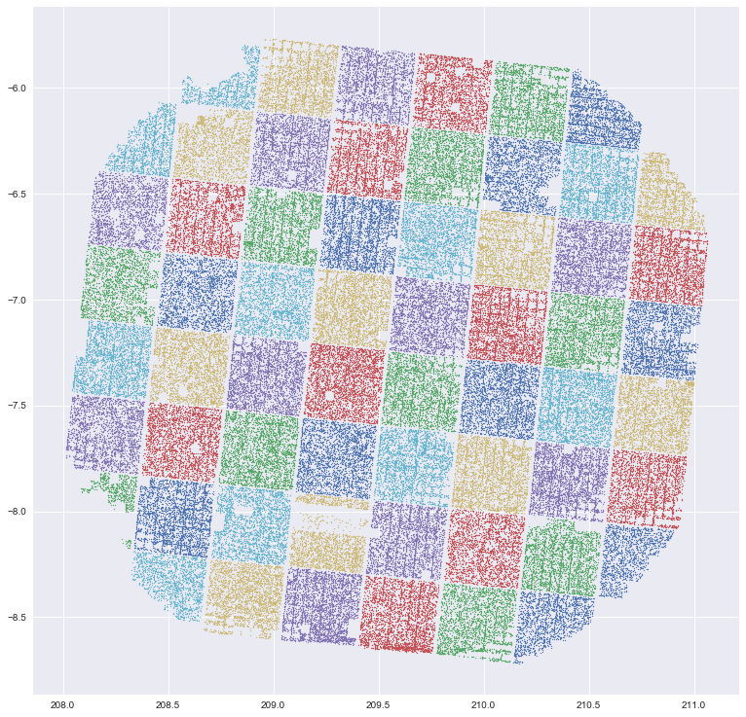
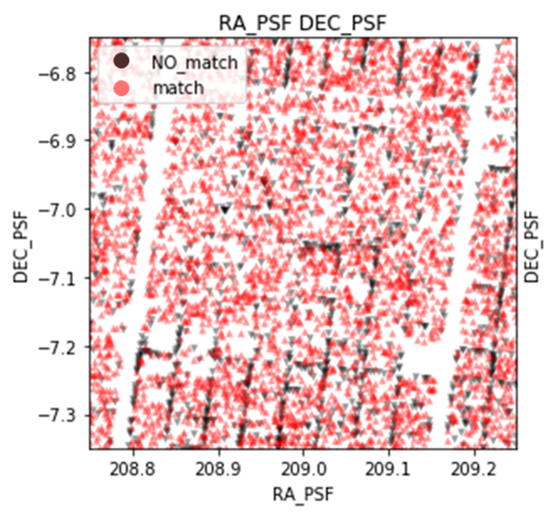
A Real-Bogus Classifier for Astronomical Data
Zizheng Xu, Manish Reddy Vuyyuru, Yuhao Lu AC209b Advanced Topics in Data Science project

Slide 2
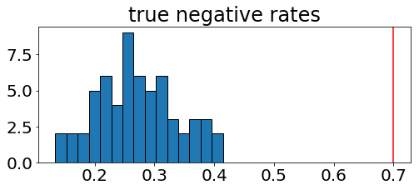
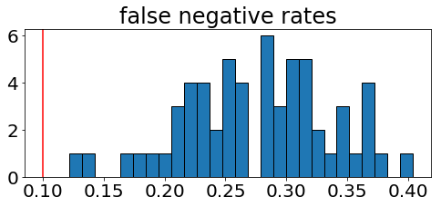
Metrics & Random Classifiers
Expectations on the expected ratios of true detections to noise
Need to retain most of catalog labels (very likely true detections)

Slide 3
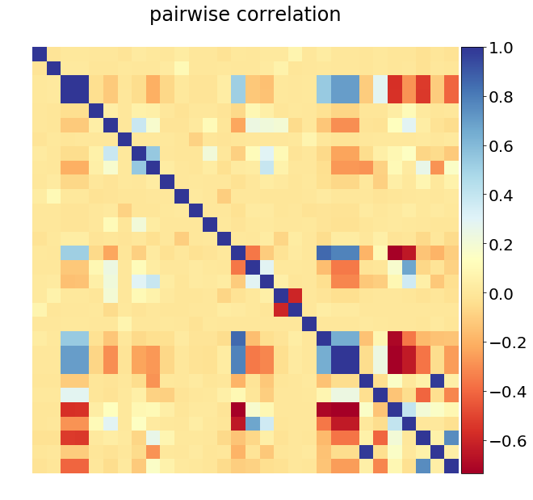
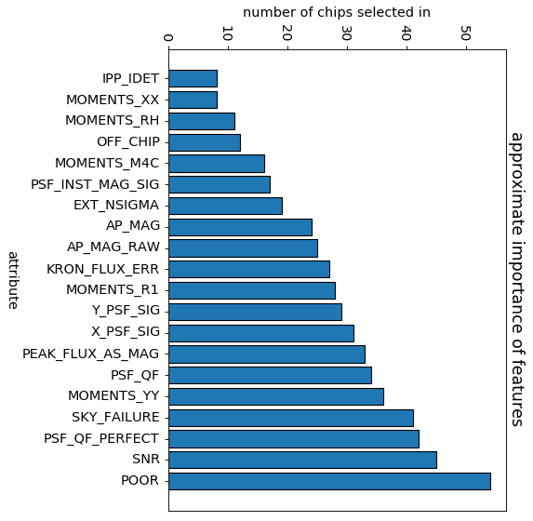
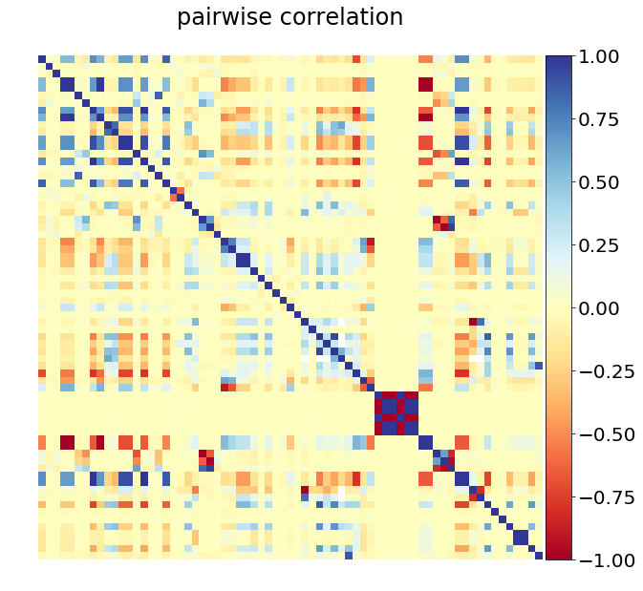
Feature Engineering
Feature Candidates
All Features

Slide 4
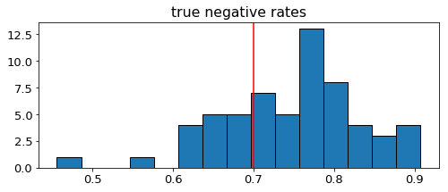
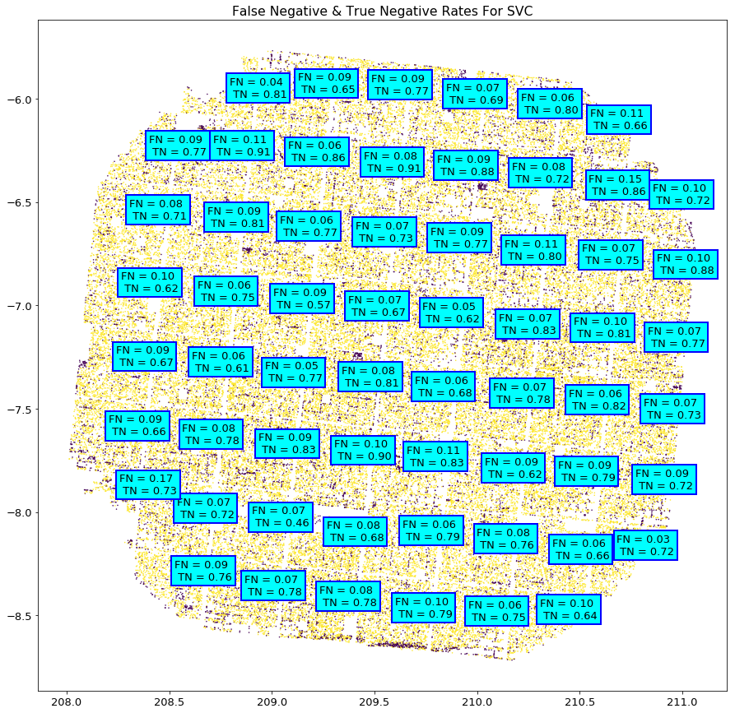
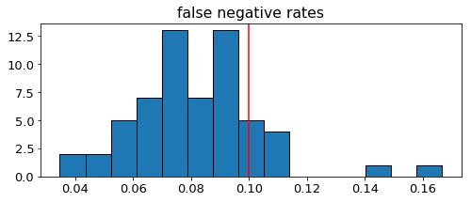
Linear Classifiers

Slide 5
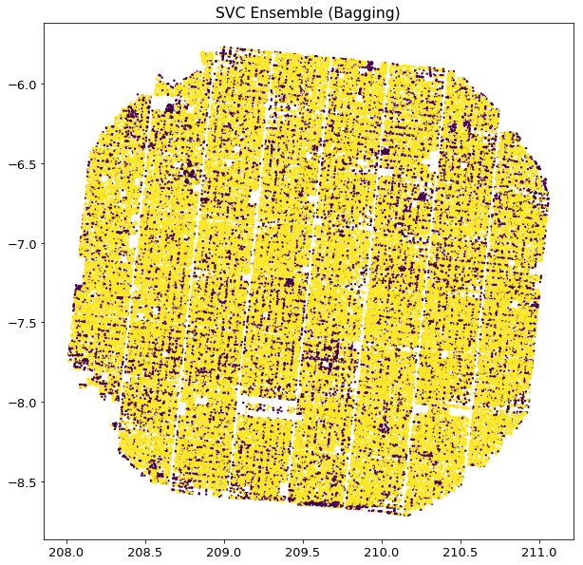
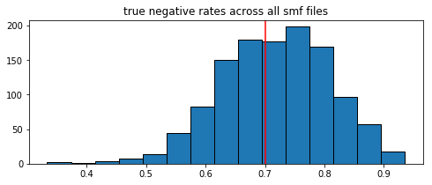
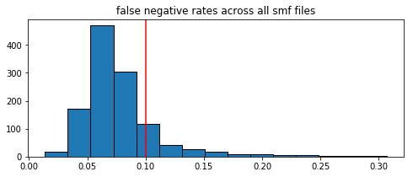
Ensembles

Slide 6
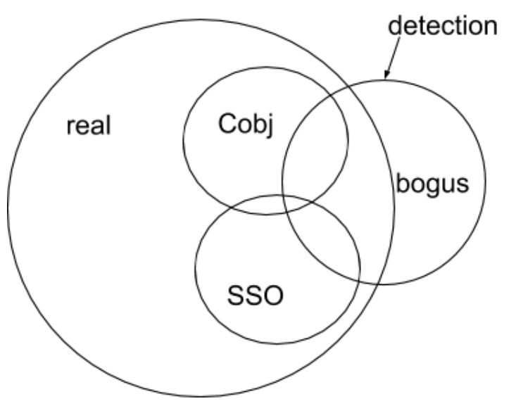
Supervised vs. Unsupervised Methods
Supervised methods can only chase the catalog.
Need to use catalog as a prior to reveal natural clustering.

Slide 7
Metrics For Clustering
Recall Rate: a probe of how well the method is picking up signal
Bogus Rate: ensure the outcome is not trivally predicting one labels for the whole time
Edge Bogus Rate: expect more bogus detections on cell edges
Consistency: same rates within one chip, across train/test split

Slide 8
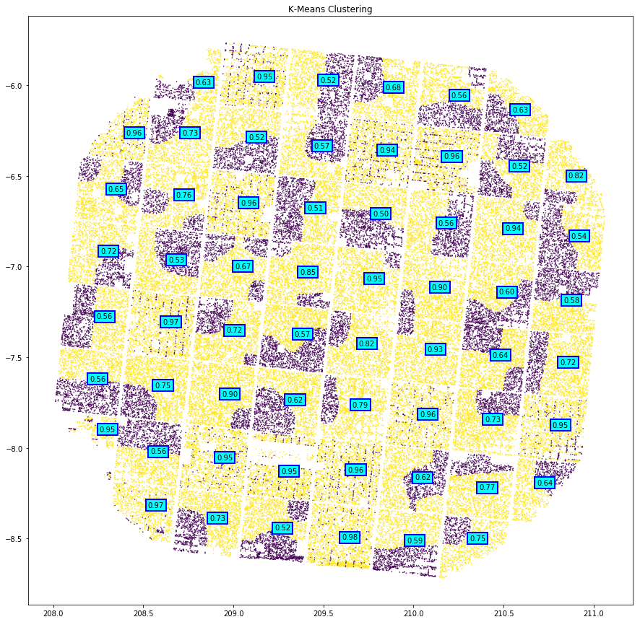
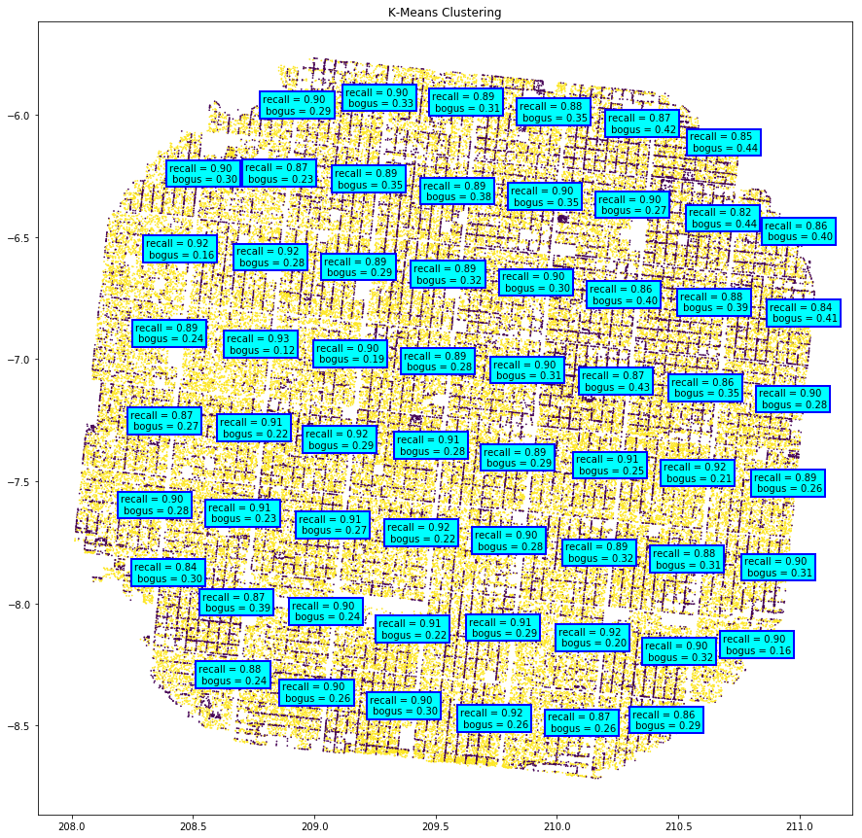
Baseline Kmeans
Random initialization
Problem: flip of labels
2. Initialized Kmeans
Fixed label-flipping issue

Slide 9
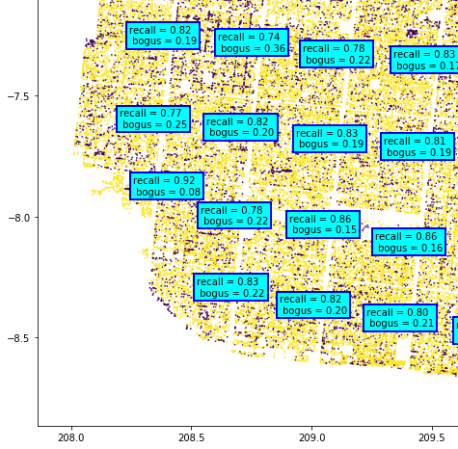
3. EM algorithm (w/Gaussian mixture models)
Successfully picked up cell edges in some chips
Successfully picked up “edge-bogus”s
Problems:
Recall rate low
Edge-bogus rate not consistent over chips

Slide 10
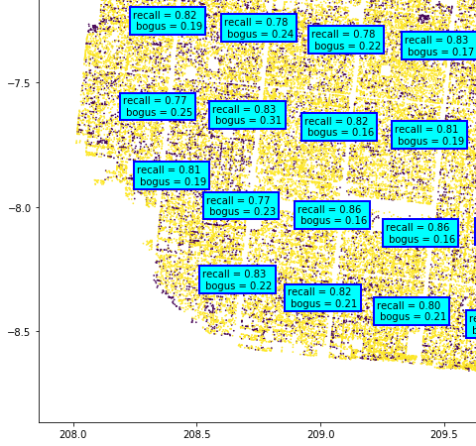
4. EM algorithm with
engineered prior
Assigned narrower prior reflecting confidence in catalog
Pluses:
Better picked up edge-boguses
Reports malfunctioning cells (hot pixels)

Slide 11
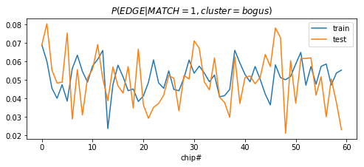
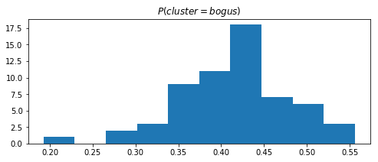
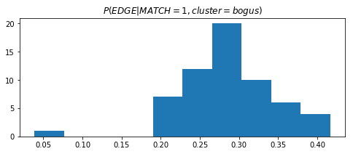
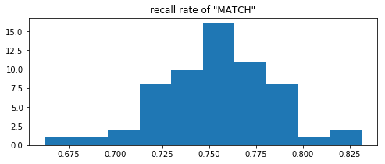
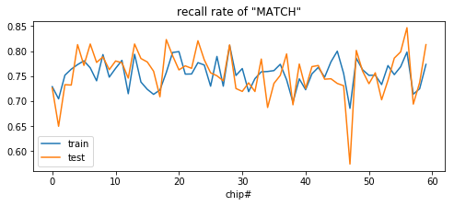
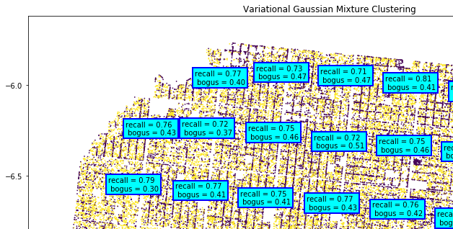
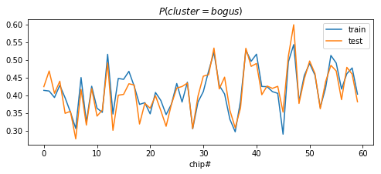
5. Variational Gaussian mixture models
pvalue: 0.91
pvalue: 0.59
pvalue: 0.51

Slide 12
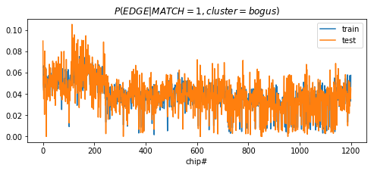
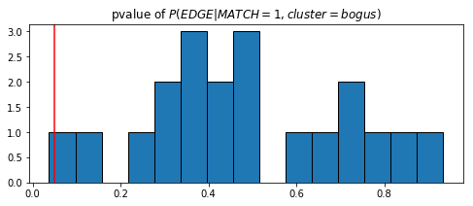
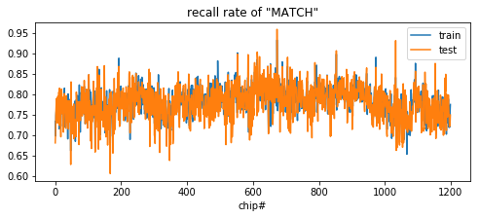
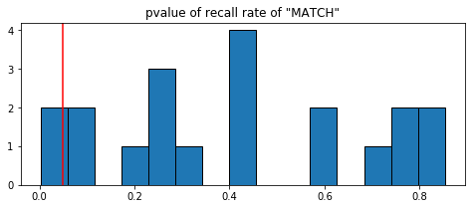
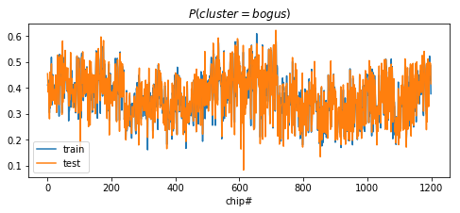
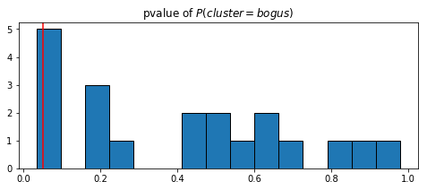
Performance of Variational Gaussian Mixture Model
clustering consistent within chips across smf files
α=0.05

